Slide 1

Sound data
The Pursuit of the Ideal Song

Slide 2

Team members
GA Tech Data Boot Camp
Project 1
January 2023
Miodrag Radovic (Misko)
Priscila Briggs
Sea Gun Lee
Ershad Ziaei

Slide 3

What makes a popular song a popular song?
How have the characteristics of a popular song changed over time?
What are the most popular genres nowadays?

Slide 4

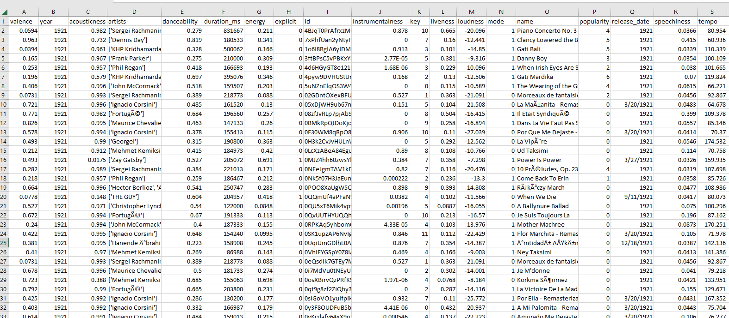
Resource dataset
more than 175,000 songs
from 1921 to 2020
collected from Spotify Web API.
(https://data.world/babarory/spotify-dataset-1921-2020)

Slide 5

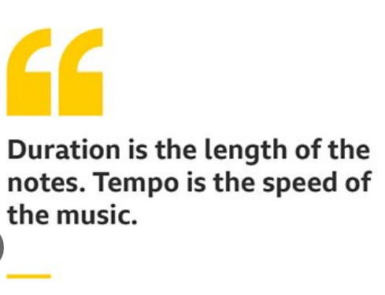
Variables to investigate
Duration
Indicates the length of the track.
Unit: milliseconds.
Tempo
A song's tempo is its speed, or the number of beats per minute (BPM). In musical terminology, tempo is the speed or pace of a given piece and derives directly from the average beat duration.

Slide 6
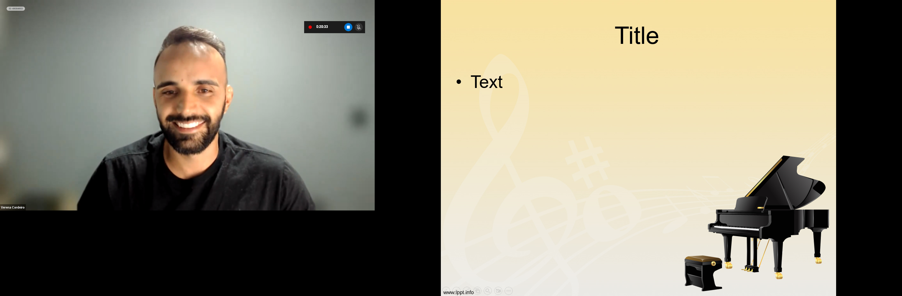
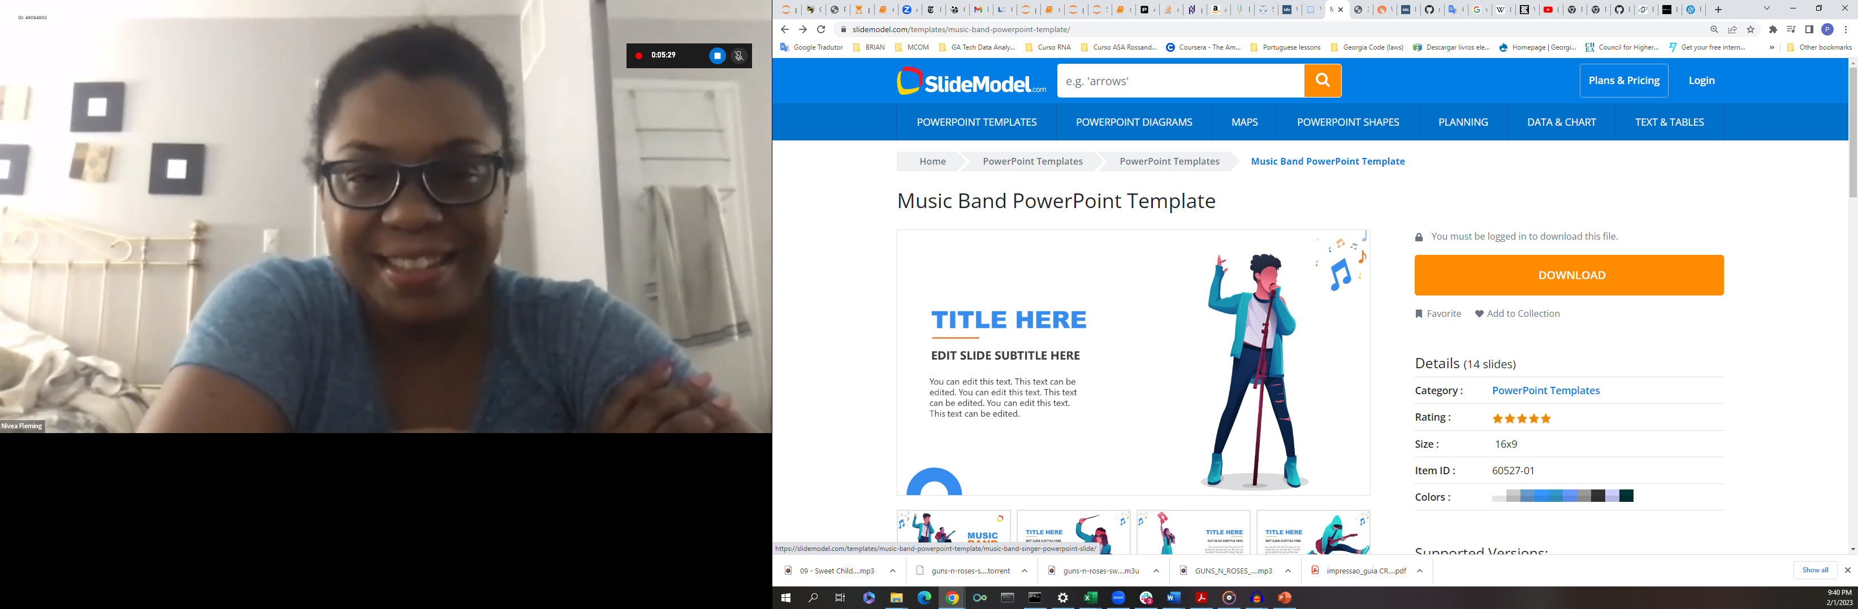
Variables to investigate
Instrumentalness
Predicts whether a track contains no vocals. “Ooh” and “aah” sounds are treated as instrumental in this context. Rap or spoken word tracks are clearly “vocal”.
Values: 0.0 to 1.0 (the lower the value the more words the song contains; value 1.0 indicates that there are no words at all.)
Speechiness
Detects the presence of spoken words in a track.
Values: 0.0 to 1.0
may contain both music and speech, such as rap music
probably all spoken words (e.g. talk show, audio book etc.)
most likely non-speech-like tracks
0
speechiness
1
0.33
0.66

Slide 7
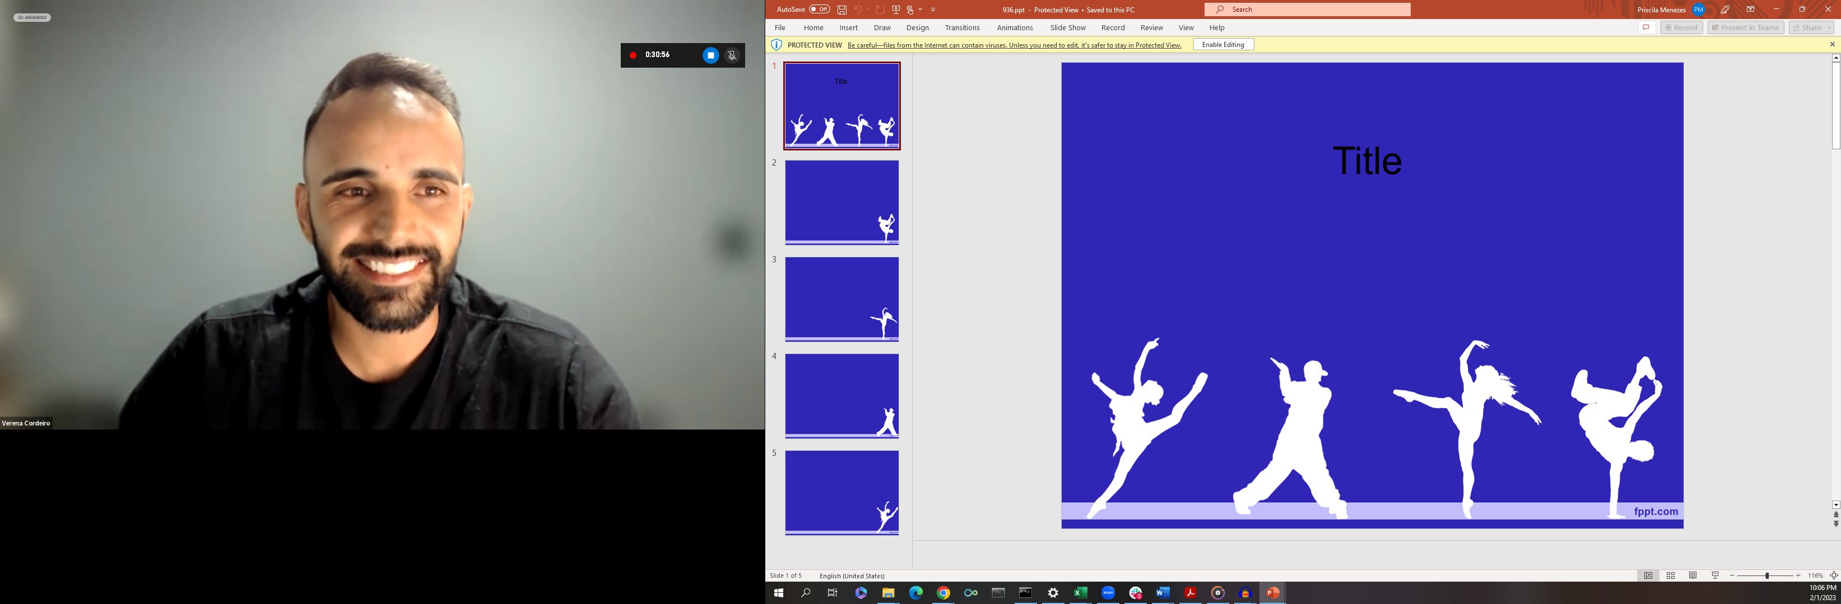
Variables to investigate
Valence
Describes the musical positiveness conveyed by a track.
Values: 0.0 (more negative - e.g. sad, depressed, angry) to 1.0 (more positive - e.g. happy, cheerful, euphoric).
Danceability
Danceability describes how suitable a track is for dancing based on a combination of musical elements including tempo, rhythm stability, beat strength, and overall regularity.
Values: 0.0 (least danceable) to 1.0 (most danceable)

Slide 8
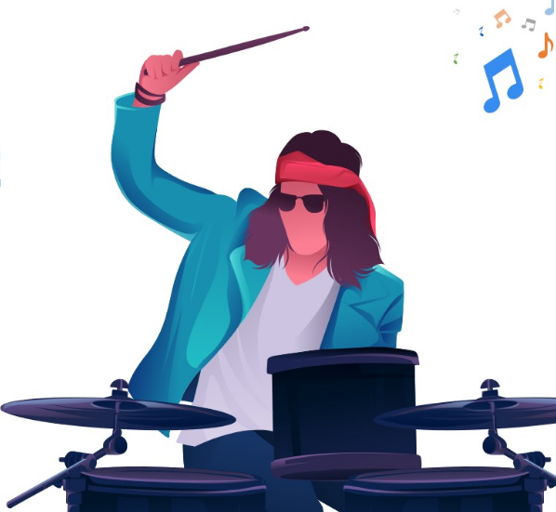
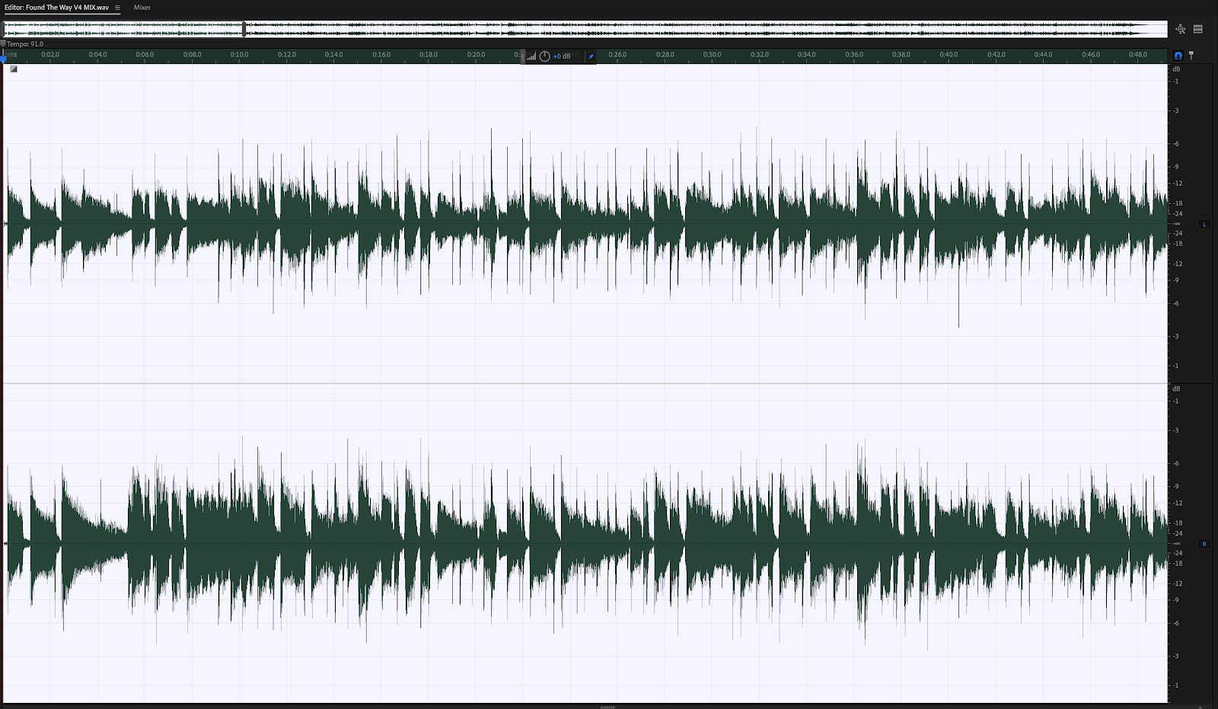
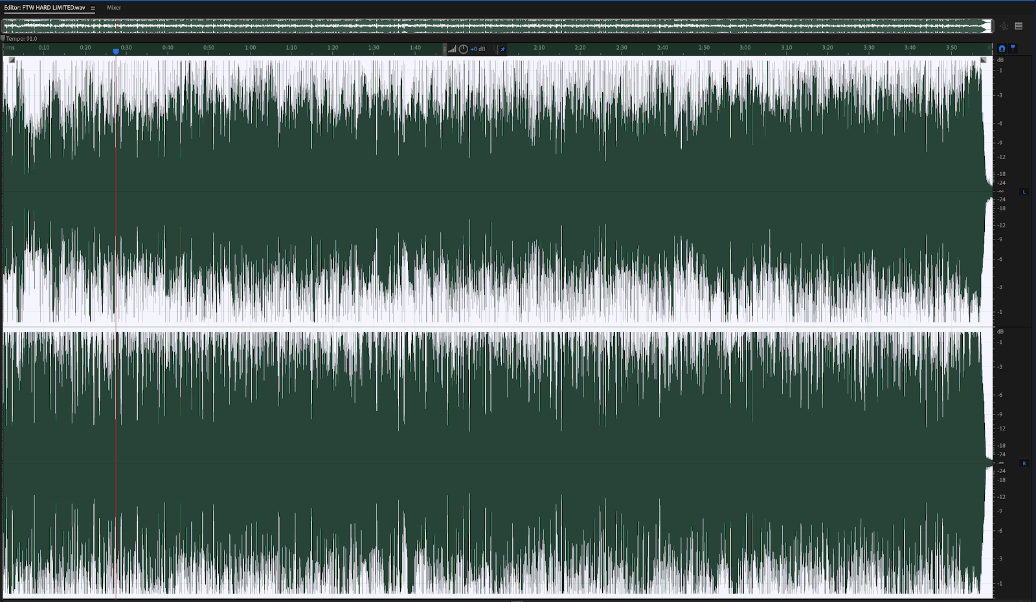
Variables to investigate
Energy
Represents a perceptual measure of intensity and activity. Typically, energetic tracks feel fast, loud, and noisy.
Values: 0.0 (~Bach prelude) to 1.0 (~death metal )
Loudness
The overall loudness of a track in LUFS. In acoustics, loudness is the subjective perception of sound pressure, i.e., it is a way to measure audio levels based on the way humans perceive sound. Loudness values are averaged across the entire track and are useful for comparing relative loudness of tracks.
original
loud

Slide 9
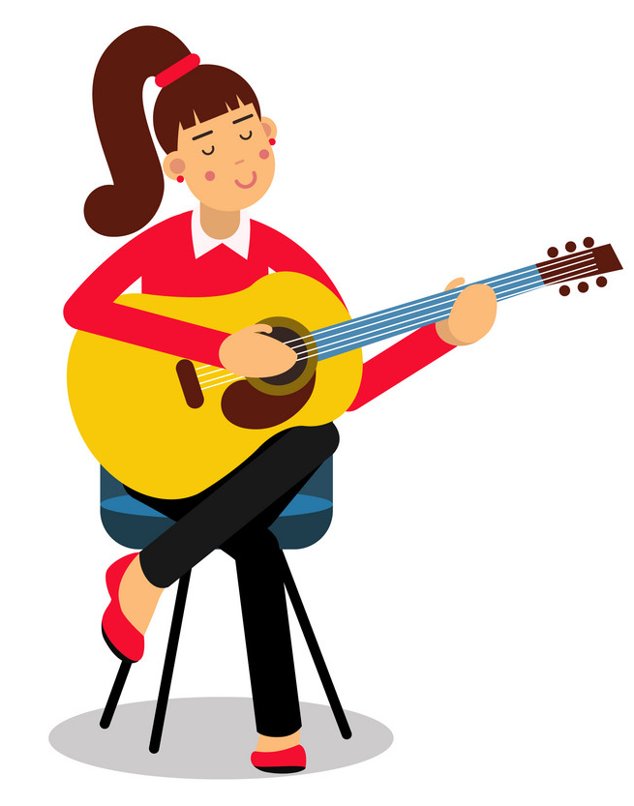
Variables to investigate
Liveness
Detects the presence of an audience in the recording. Higher liveness values represent an increased probability that the track was performed live.
Values: 0.0 to 1.0 (above 0.8 = strong likelihood that the track is live.)
Acousticness:
It’s a confidence measure that describes whether the song uses primarily acoustic instruments or electronic/electric instruments.
Values: 0.0 to 1.0 (high confidence the track is acoustic)

Slide 10
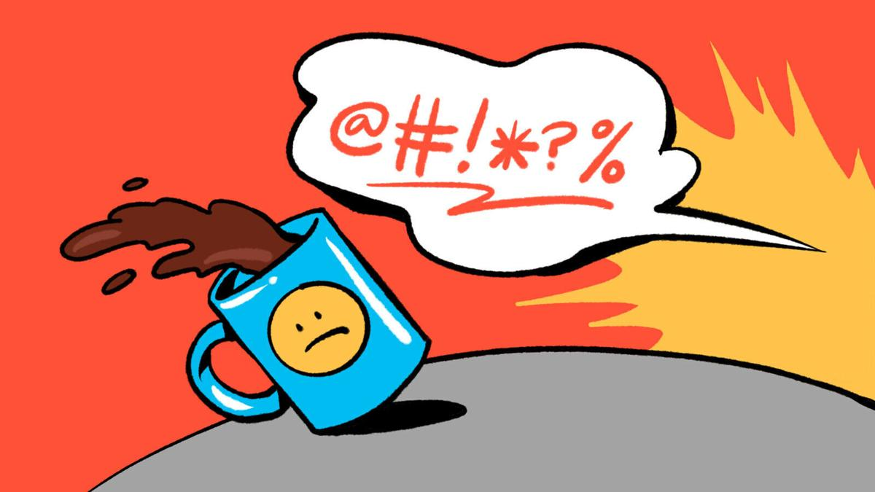
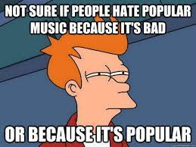
Variables to investigate
Explicitness
An explicit track is one that has curse words or language or art that is generally deemed sexual, violent, or offensive in nature.
Values: 0 (not explicit) or 1(explicit)
Popularity
The popularity of the track. The popularity is calculated by algorithm and is based, in the most part, on the total number of plays the track has had and how recent those plays are. Generally speaking, songs that are being played a lot now will have a higher popularity than songs that were played a lot in the past.
Values: 0 (least popular) to 100 (most popular)

Slide 11
What makes a popular song a popular song?

Slide 12
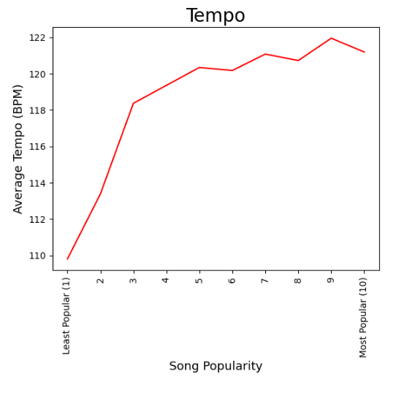
Faster tempo
≈ 121.2 BPM
is the ideal speed

Slide 13
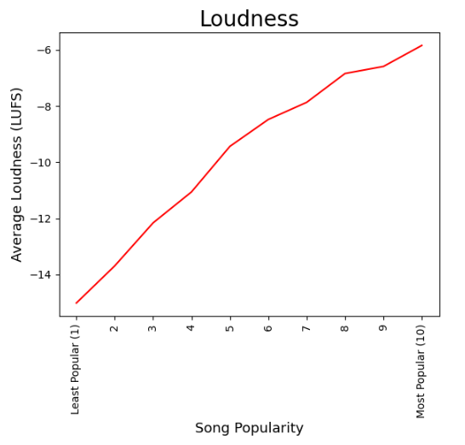
Uniform volume throughout
≈ -5.85 LUFS
is the ideal loudness

Slide 14
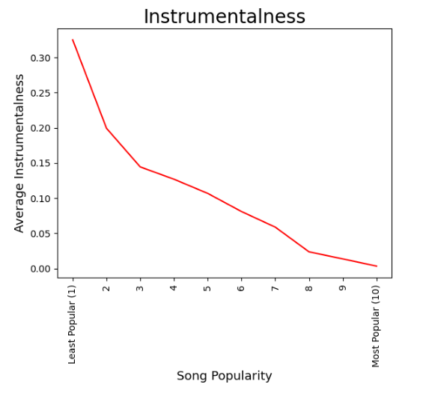
More vocals

Slide 15
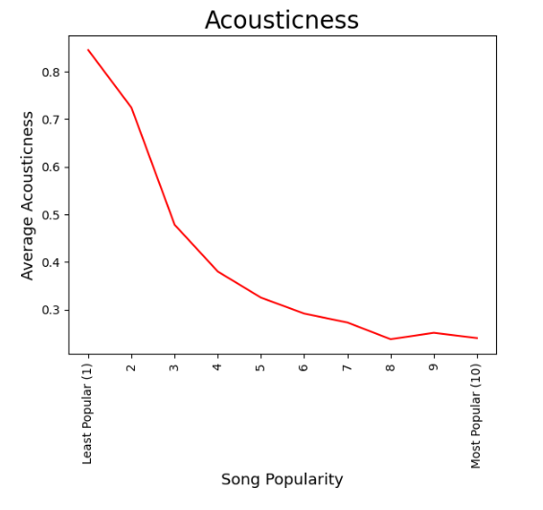
More electronic

Slide 16
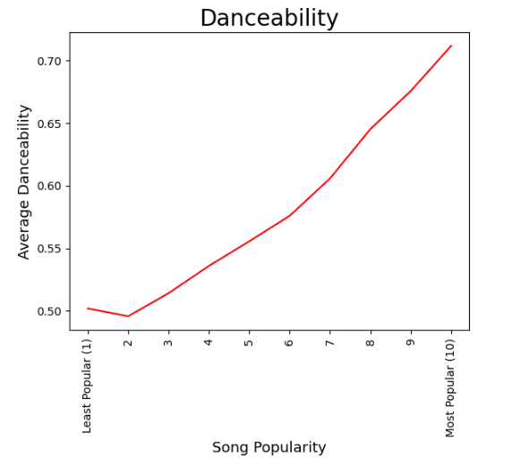
Danceable

Slide 17
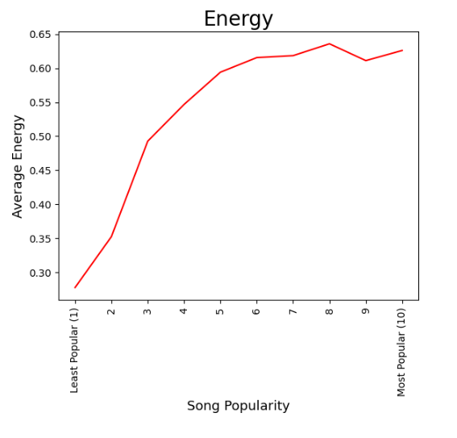
Energetic

Slide 18
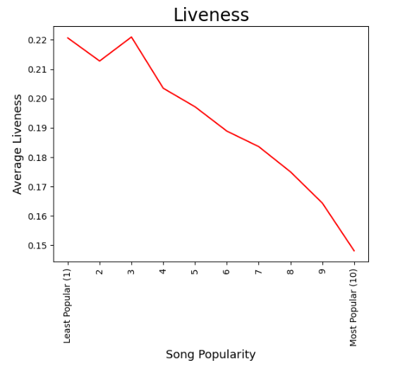
More studio-oriented

Slide 19
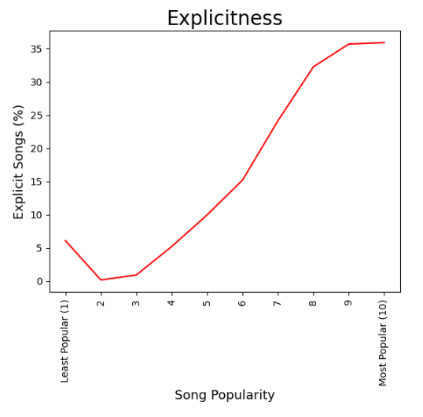
Explicit*

Slide 20
Decade Analysis

Slide 21
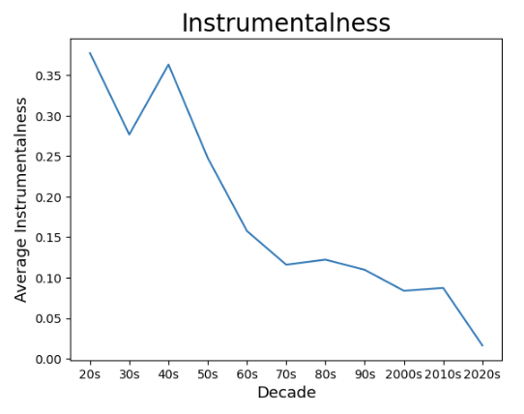
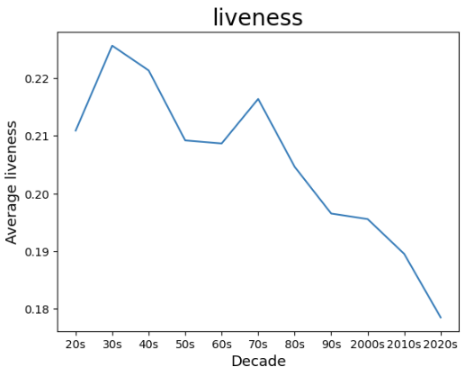
DECADE ANALYSIS (Instrumentalness and Liveness)
Overall Descending Trend
Overall Descending Trend

Slide 22
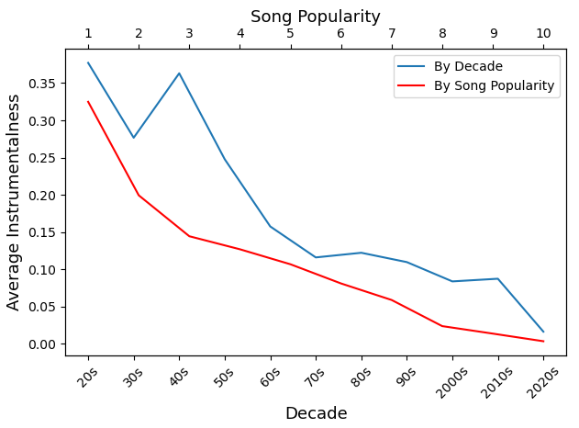
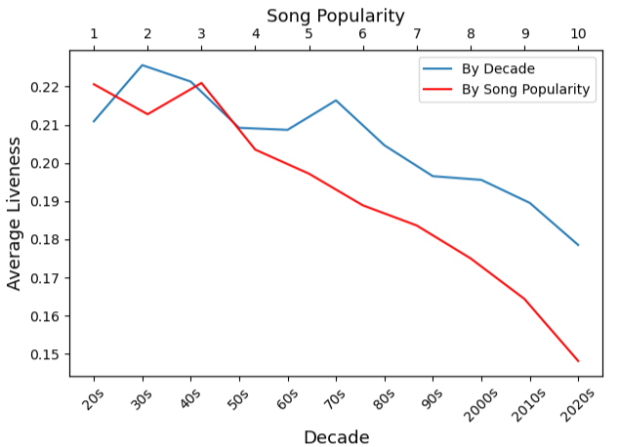
DECADE AND POPULARITY ANALYSIS (Instrumentalness and Liveness)

Slide 23
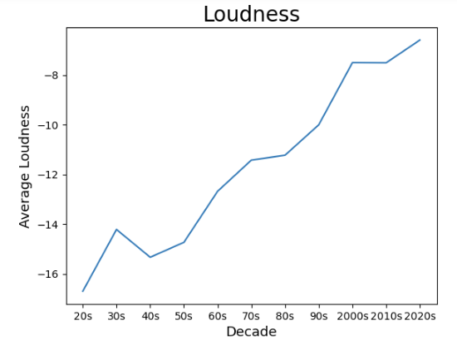
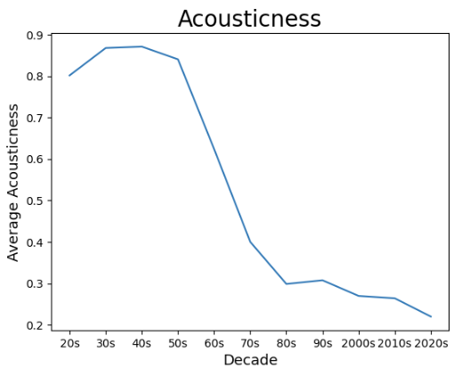
DECADE ANALYSIS (Loudness and Acousticness)
Overall Ascending Trend
Overall Descending Trend

Slide 24
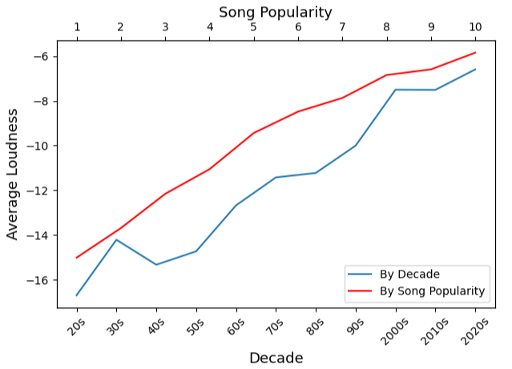
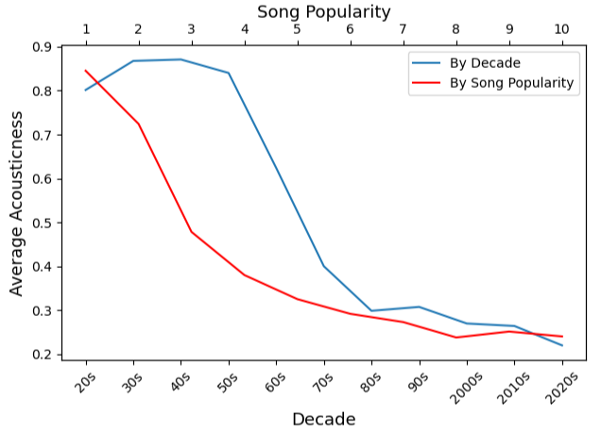
DECADE AND POPULARITY ANALYSIS (Loudness and Acousticness)

Slide 25
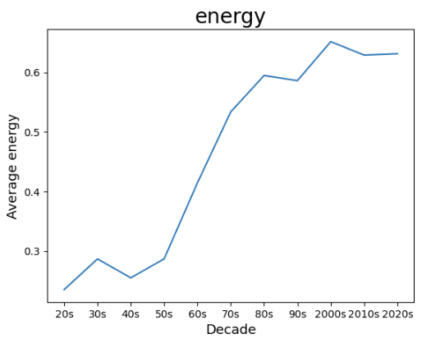
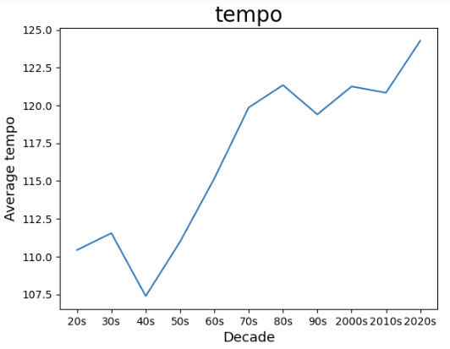
DECADE ANALYSIS (Energy and Tempo)
Overall Ascending Trend
Overall Ascending Trend

Slide 26
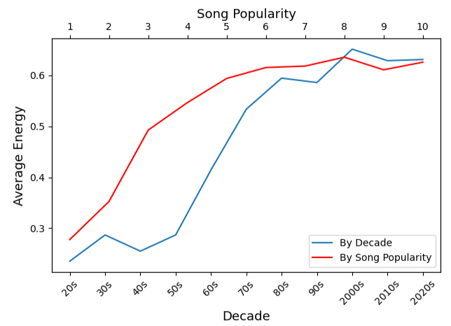
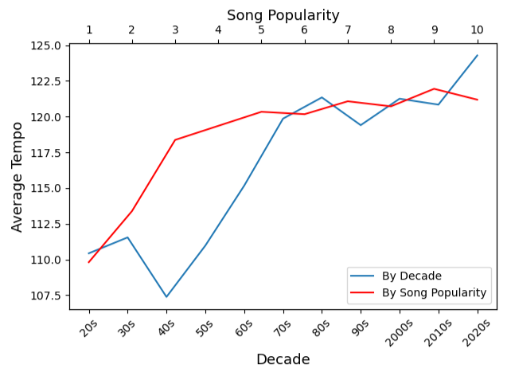
DECADE AND POPULARITY ANALYSIS (Energy and Tempo)

Slide 27
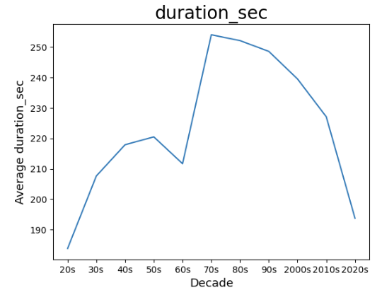
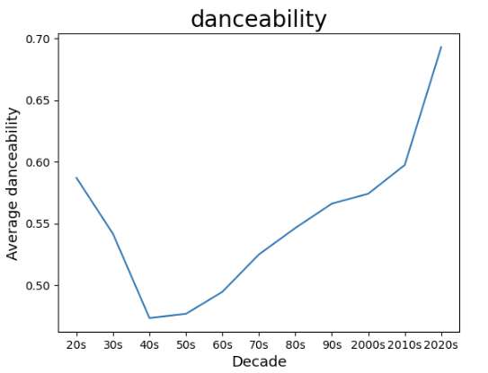
DECADE ANALYSIS (Duration and Danceability)
Overall Polynomial Trend
Overall Polynomial Trend

Slide 28
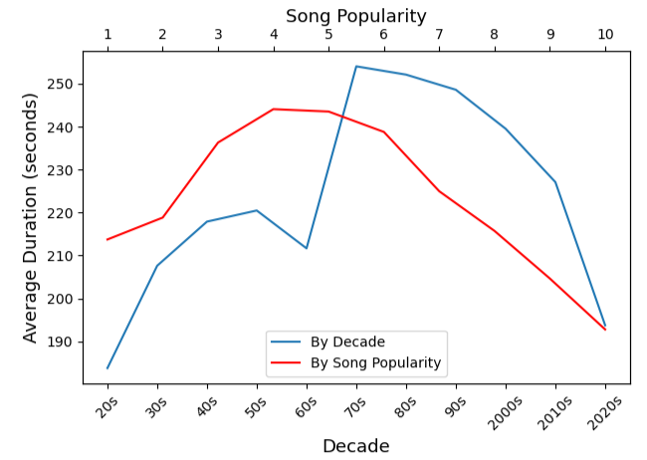
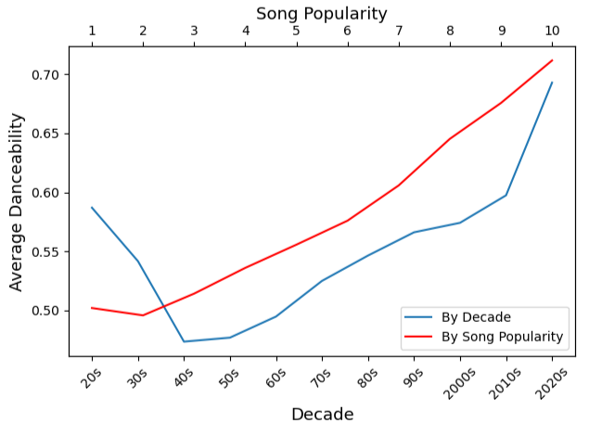
DECADE AND POPULARITY ANALYSIS (Duration and Danceability)

Slide 29
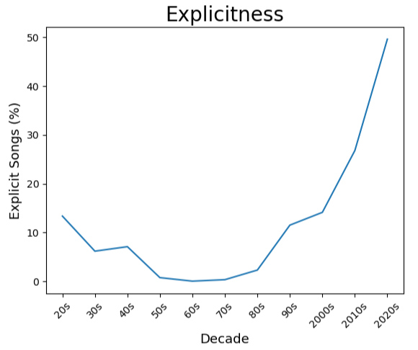
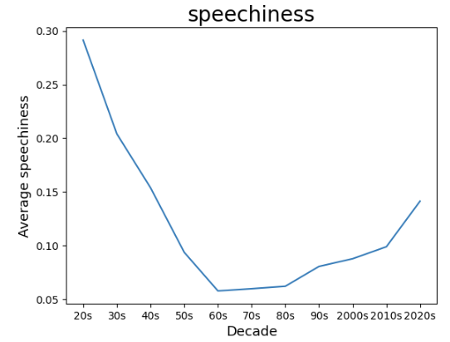
DECADE ANALYSIS (Explicit and Speachness)
Overall Polynomial Trend
Overall Polynomial Trend

Slide 30
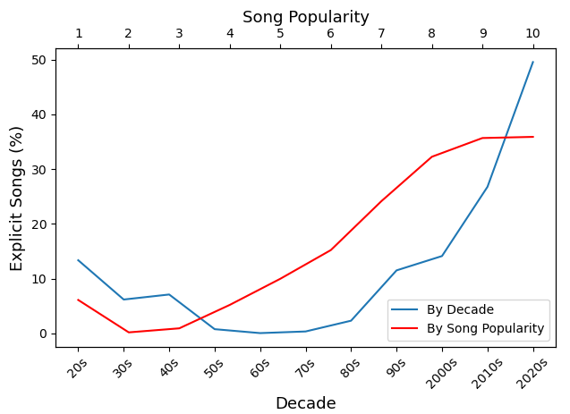
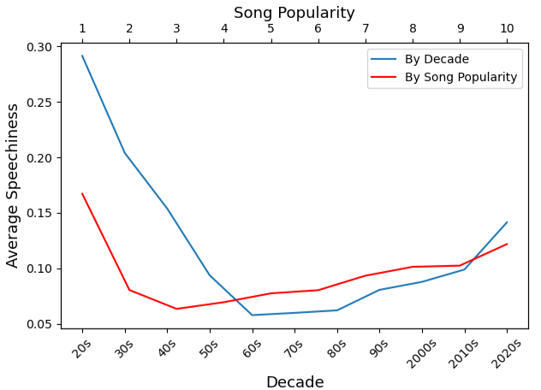
DECADE AND POPULARITY ANALYSIS (Explicit and Speachness)

Slide 31
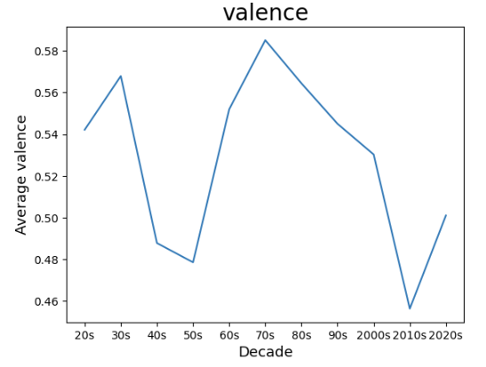
DECADE ANALYSIS (Valence)
No Trend

Slide 32
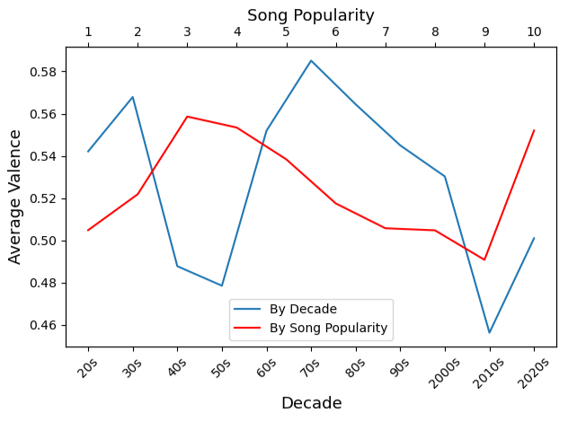
DECADE AND POPULARITY ANALYSIS (Valence)

Slide 33
Conclusion

Slide 34
What does popular mean?
Definition: liked, admired, or enjoyed by many people or by a particular person or group
Popular songs are the ones that are liked and enjoyed by many people; it does not define quality. Rather, it defines taste and occurrence.

Slide 35
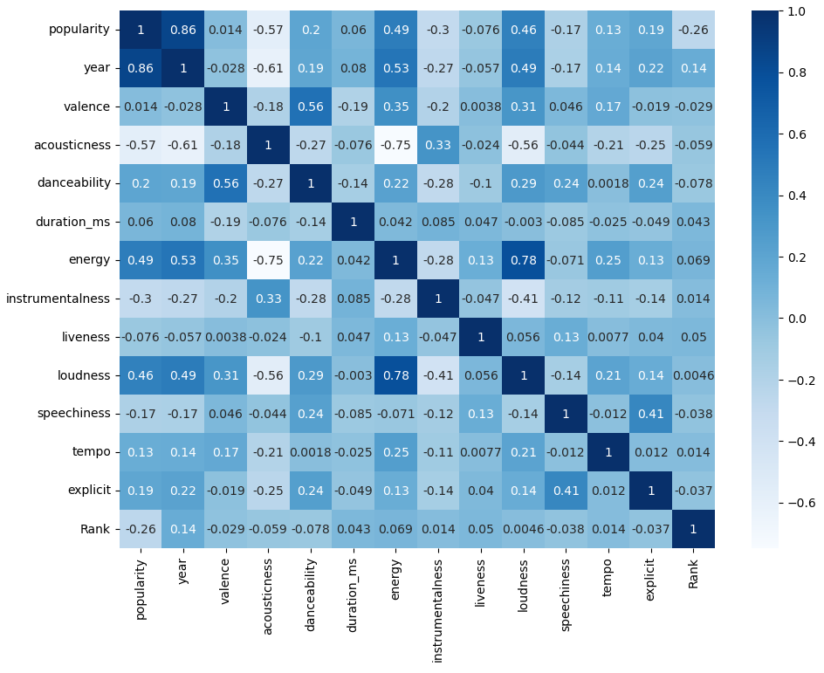
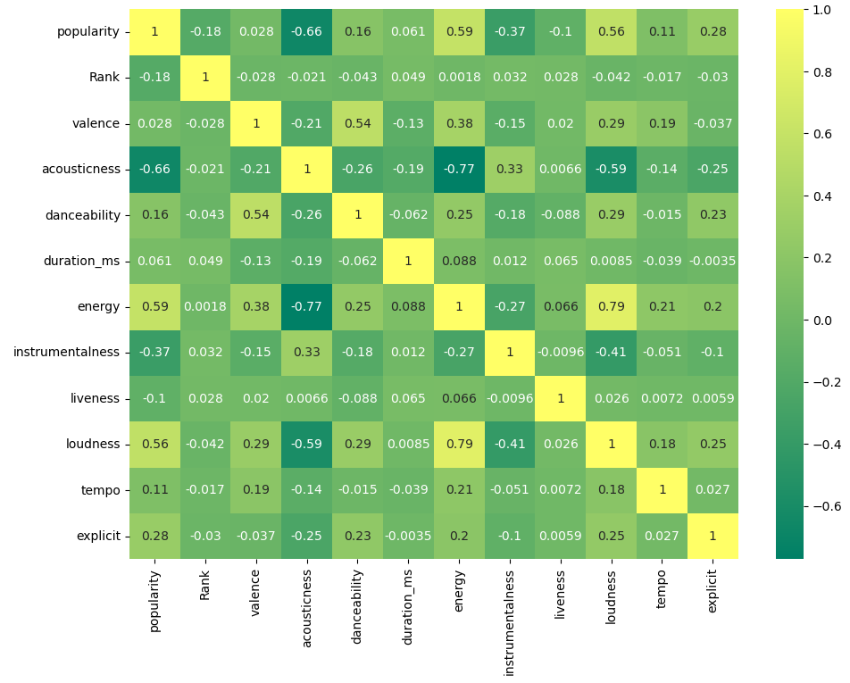
All Songs Analysis
10% Each Decade
BIG 4
Variables with Strongest Correlation to Popularity: acousticness, energy, instrumentalness, loudness

Slide 36
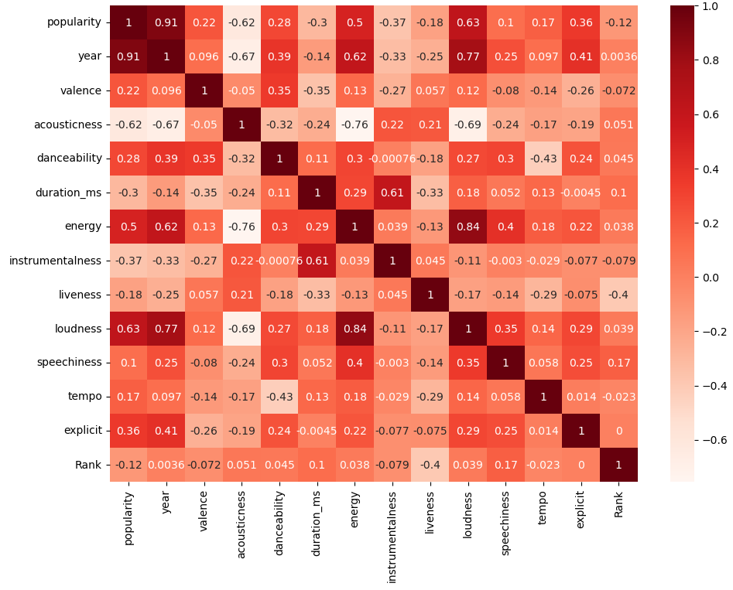
Looking at it in more DEPTH!
Top 3 songs of each decade is still showing the strong correlation of popularity and the BIG 4.
New Addition: Explicitness
3 Most Popular Songs Each Decade

Slide 37
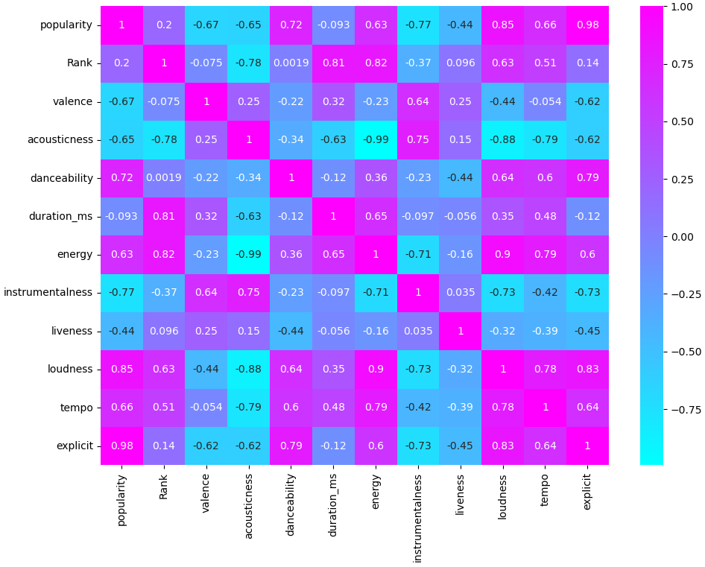
Popularity over 30
In Spotify, songs with popularity of 30 are considered popular, visible enough to be recommended to personal song charts.
With other characteristics still showing correlation to popularity, BIG 4 still shows strong, same correlation to the popularity of songs.
Explicitness showed the strongest correlation to increasing popularity of the songs.

Slide 38
Ranged by Popularity
As popularity increases, BIG 4 displayed strongest changes from the lowest range to highest range popularity.
Interesting Fact: Songs were becoming more explicit as the songs became more popular.

Slide 39
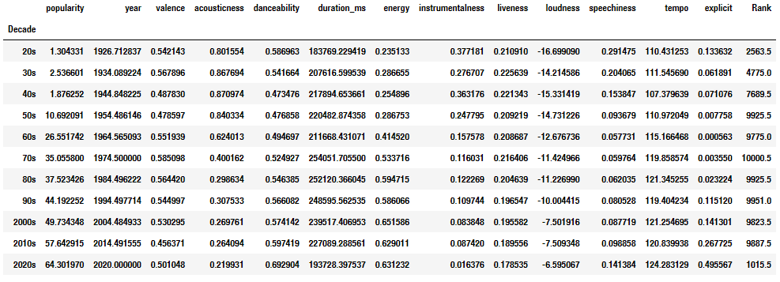
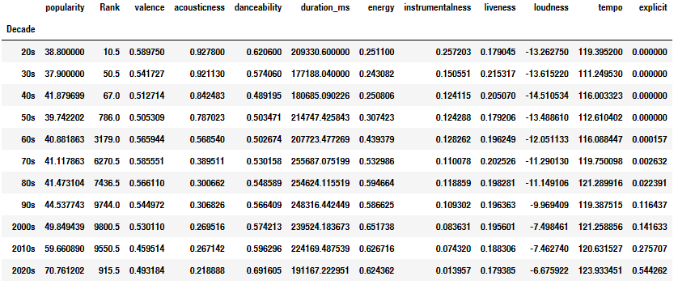
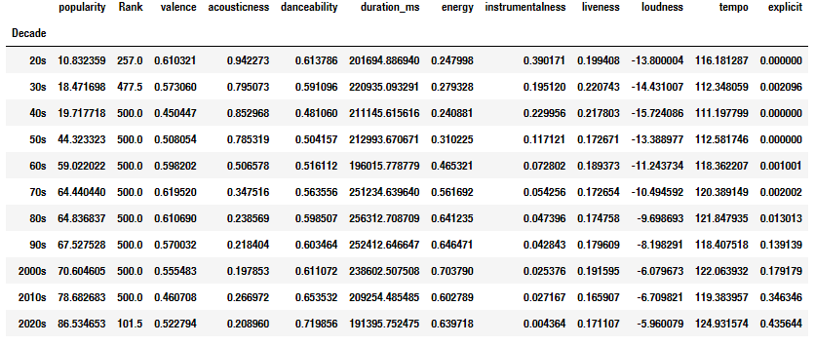
In Depth Look Into Explicitness
Songs by Decade
Songs over 30 Popularity
Songs by Decade
In every analysis, songs became more explicit as the popularity increased.
As the year progressed, explicitness increased.
ANALYSIS: Explicit songs became more likable and popular through the years as society became more acceptable to such culture.

Slide 40
Final Conclusion from the Analysis
What makes a popular song a popular song?
Popularity increases as the songs became:
Less acoustic, more electronic (negative trend in acousticness)
Louder in average volume (positive trend in loudness)
More vocal (negative trend in instrumentalness)
More energetic (positive trend in energy)
More explicit in its choice of words and expression (positive trend in explicit)
More recent in its release date (positive trend in year)
Yearly trend graph for each variable closely resembles those of popularity trend.

Slide 41
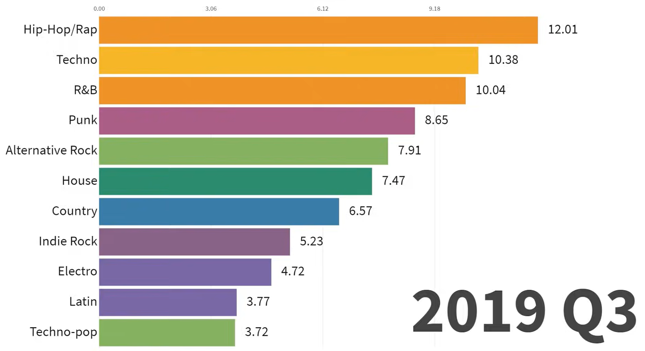
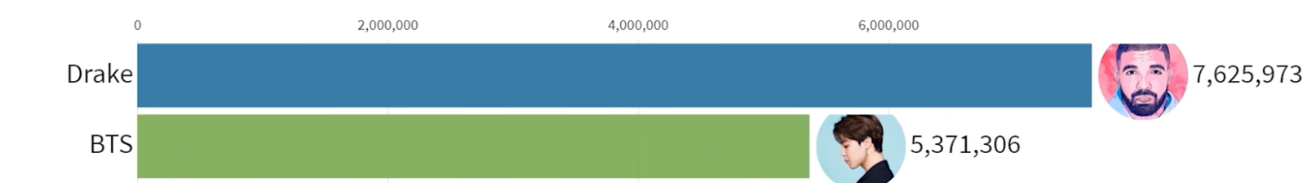
What are the most popular genres nowadays?
Final Conclusion from the Analysis
Hip-Hop/Rap is the most popular genre of the recent decade, followed by Techno and R&B.
Two Best selling artist of the same period are Drake and BTS
Data Source: Discogs, Billboard, Spotify
Data Source: RIAA, IFPI

Slide 42
References
https://data.world/babarory/spotify-dataset-1921-2020
https://www.pngitem.com/middle/mwTiwb_spotify-logo-small-spotify-logo-transparent-hd-png/
https://github.com/zhao1701/spotify-song-lyric-analysis/blob/master/readme.md
https://towardsdatascience.com/what-makes-a-song-likeable-dbfdb7abe404
https://towardsdatascience.com/is-my-spotify-music-boring-an-analysis-involving-music-data-and-machine-learning-47550ae931de#:~:text=Speechiness%3A%20%E2%80%9CSpeechiness%20detects%20the%20presence,does%20not%20have%20any%20speech.
https://ahsieh53632.github.io/music-attributes-and-popularity/
https://www.iconfinder.com/icons/2441881/beat_cartoon_metronome_music_rhythm_tempo_time_icon
https://www.free-power-point-templates.com/?s=music
https://www.free-power-point-templates.com/free-equalizer-ppt/#goog_rewarded
https://www.bbc.co.uk/bitesize/topics/zcbkcj6/articles/z3yfng8
https://www.vectorstock.com/royalty-free-vector/teenage-girl-playing-an-acoustic-guitar-cartoon-vector-15514835
https://slidemodel.com/?s=song
https://slidemodel.com/page/4/?s=music
https://blog.prosoundeffects.com/understanding-loudness-and-why-it-matters#:~:text=Loudness%20is%20a%20subjective%20term,%E2%80%9D%20(Merriam%2DWebster
https://iconcollective.edu/loudness-meters/
https://support.tunecore.com/hc/en-us/articles/115006691948-Explicit-and-Clean-Track-Qualifications#:~:text=An%20explicit%20track%20is%20one,also%20be%20marked%20as%20explicit.
http://www.quickmeme.com/meme/3obwso
https://tucson.com/lifestyles/health-med-fit/why-swearing-is-a-sign-of-intelligence-helps-manage-pain-and-more/article_5c0fb22b-9577-538f-9e1d-87075c7452e7.html
https://support.zoom.us/hc/en-us/articles/201362643-Sharing-computer-sound-in-a-screen-share
https://www.youtube.com/watch?v=eP88FUL7d_8&t=405s&ab_channel=DataIsBeautiful
https://www.youtube.com/watch?v=a3w8I8boc_I&ab_channel=DataIsBeautiful

Slide 43

Thank you!

